Slide 1
FEA Demo
Install the Restore Guide
2022/6/2
©2020 Shanghai Hourglass Engineering Software Ltd.

Slide 2
Content
1
Environmental And runtime list
2
Windows server settings and IIS installation
3
Runtime installation
4
MSSQL And SSMS installation
5
Platform installation Restore data DEMO
©2020 Shanghai Hourglass Engineering Software Ltd.

Slide 3
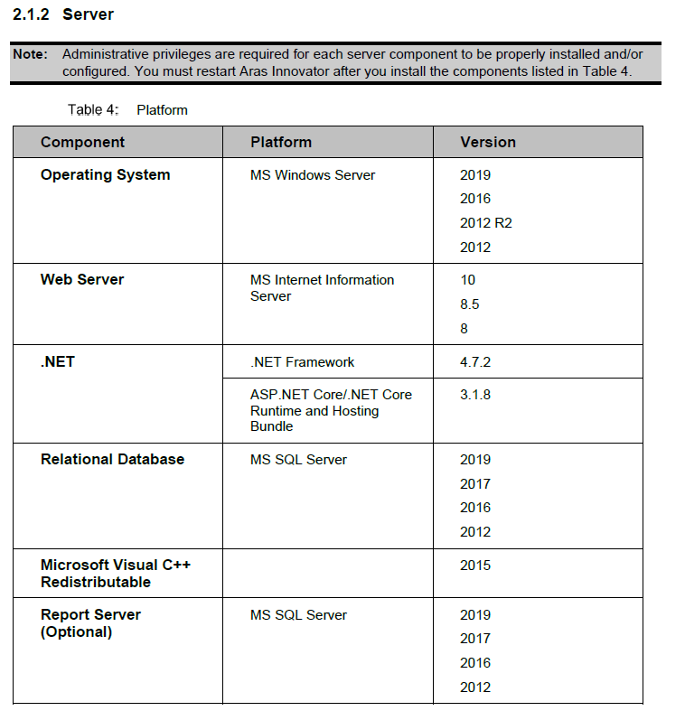
Environmental And runtime list
Details [Aras Innovator 15 - Installation Guide.pdf]
2.1.2 Server

Slide 4
Environmental And runtime list
This demo environmental
Windows Server 2019 | Prepare in advance
MS Internet Information Server 10 | Windows Server Add Roles
.NET Framework 4.7.2 | Windows Server comes with
ASP.NET Core/.NET Core Runtime and Hosting Bundle 3.1.8 | Need to download https://download.visualstudio.microsoft.com/download/pr/854cbd11-4b96-4a44-9664-b95991c0c4f7/8ec4944a5bd770faba2f769e647b1e6e/dotnet-hosting-3.1.8-win.exe
MS SQL Server 2019 | Need to download https://download.microsoft.com/download/7/f/8/7f8a9c43-8c8a-4f7c-9f92-83c18d96b681/SQL2019-SSEI-Expr.exe
SSMS-Setup-ENU | Need to download https://download.microsoft.com/download/c/7/c/c7ca93fc-3770-4e4a-8a13-1868cb309166/SSMS-Setup-ENU.exe

Slide 5
Content
1
Environmental And runtime list
2
Windows server settings and IIS installation
3
Runtime installation
4
MSSQL And SSMS installation
5
Platform installation Restore data DEMO
©2020 Shanghai Hourglass Engineering Software Ltd.

Slide 6
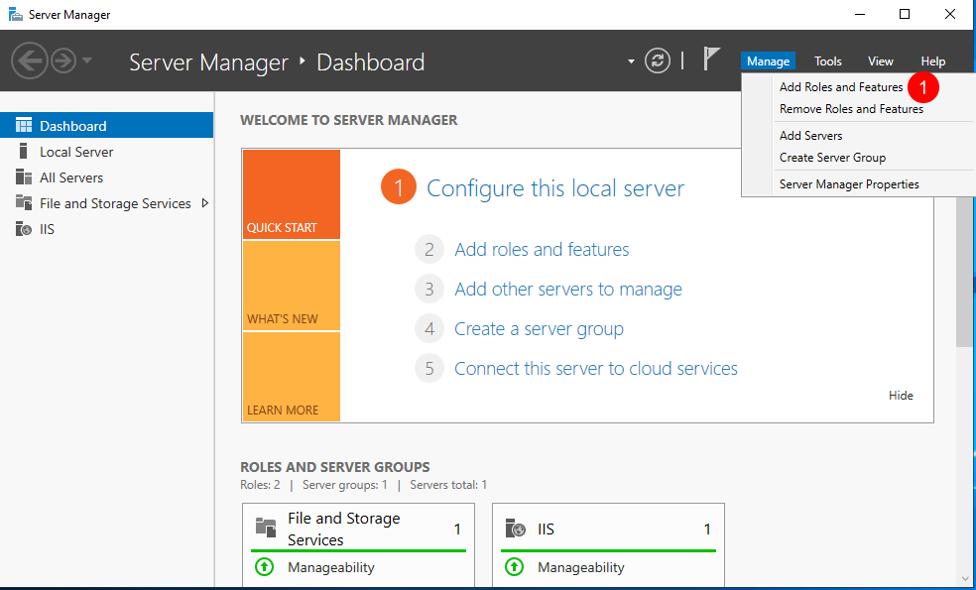
Windows server settings and IIS installation

Slide 7
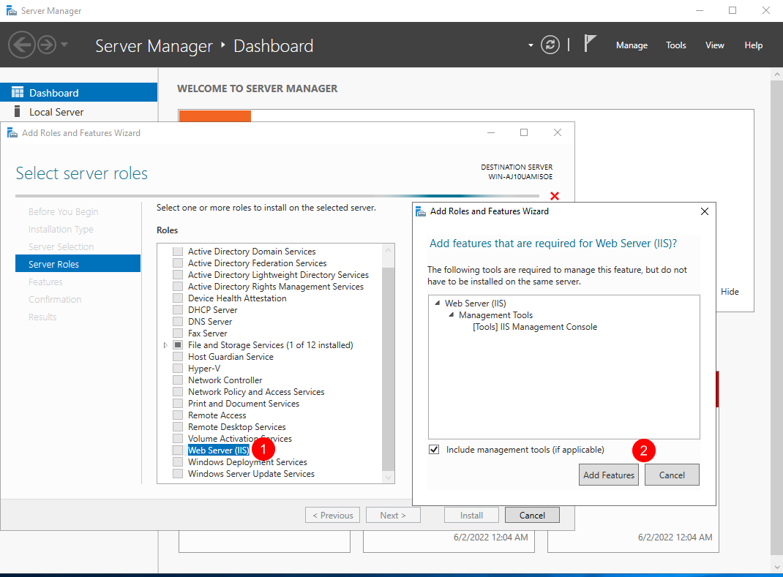
Windows server settings and IIS installation

Slide 8
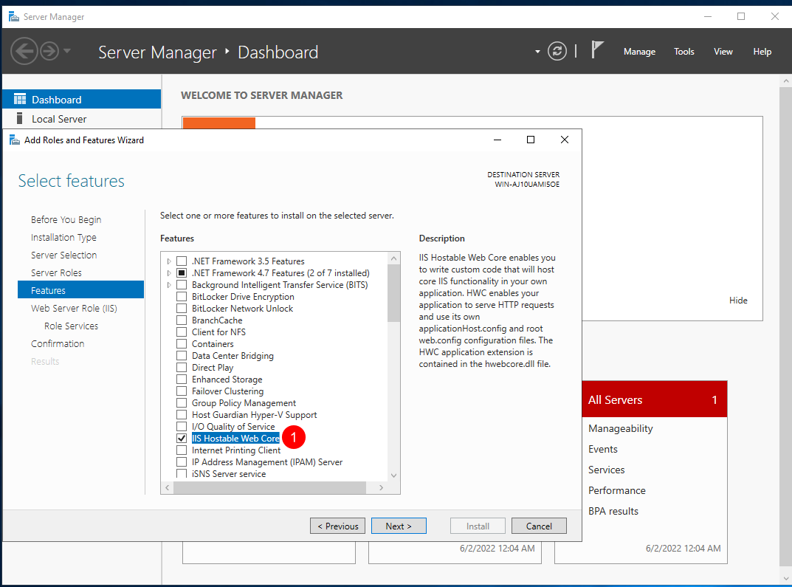
Windows server settings and IIS installation

Slide 9
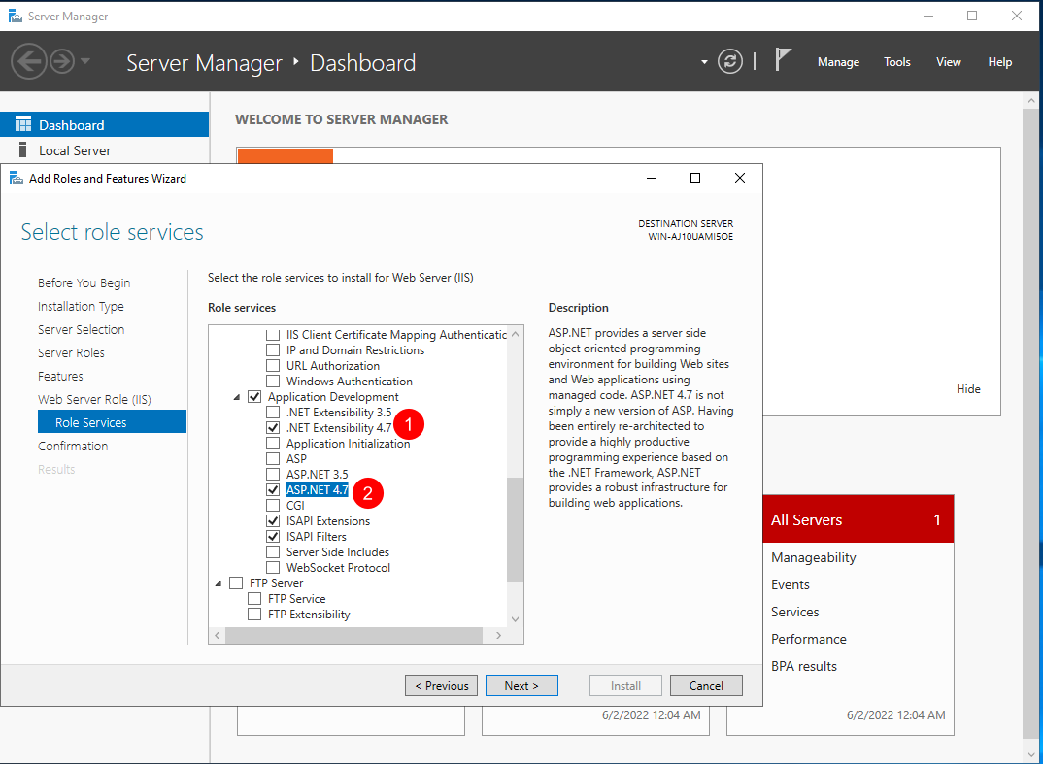
Windows server settings and IIS installation

Slide 10
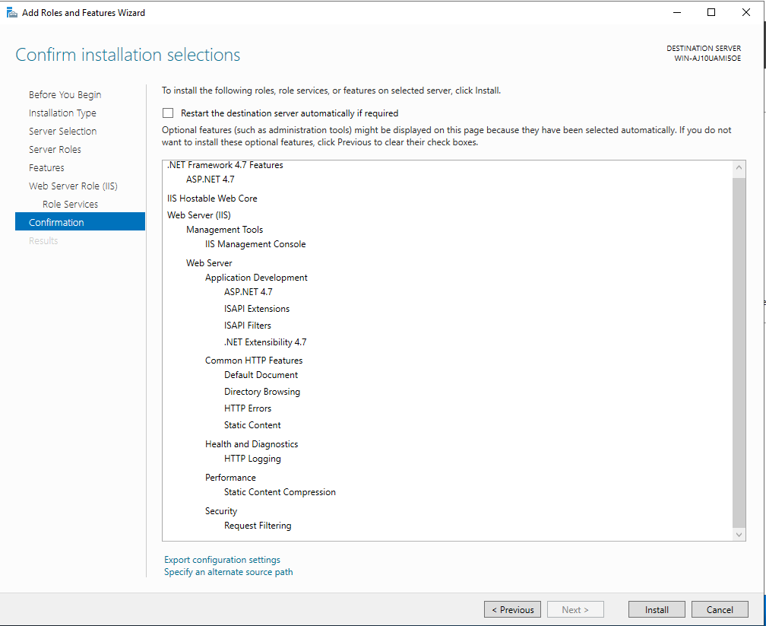
Windows server settings and IIS installation

Slide 11
Content
1
Environmental And runtime list
2
Windows server settings and IIS installation
3
Runtime installation
4
MSSQL And SSMS installation
5
Platform installation Restore data DEMO
©2020 Shanghai Hourglass Engineering Software Ltd.

Slide 12
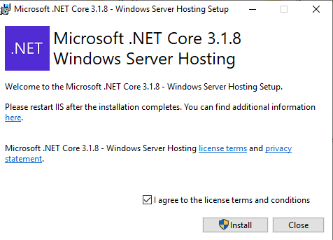
Runtime installation
Installation ASP.NET Core/.NET Core Runtime and Hosting Bundle 3.1.8

Slide 13
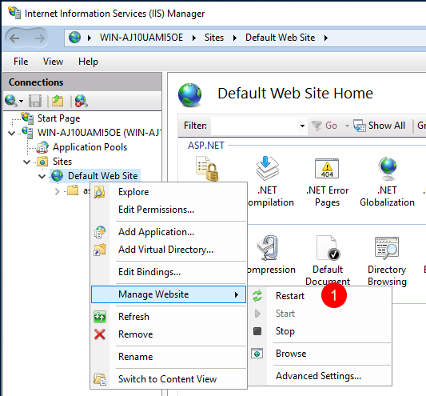
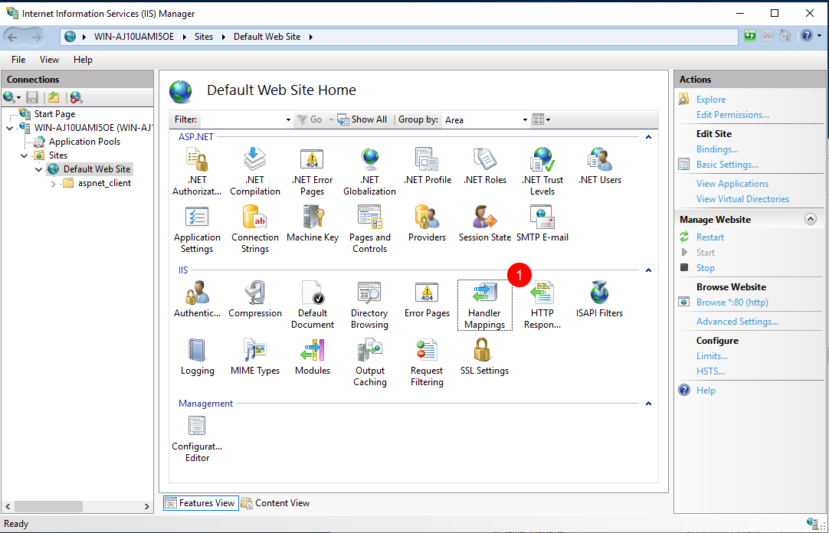
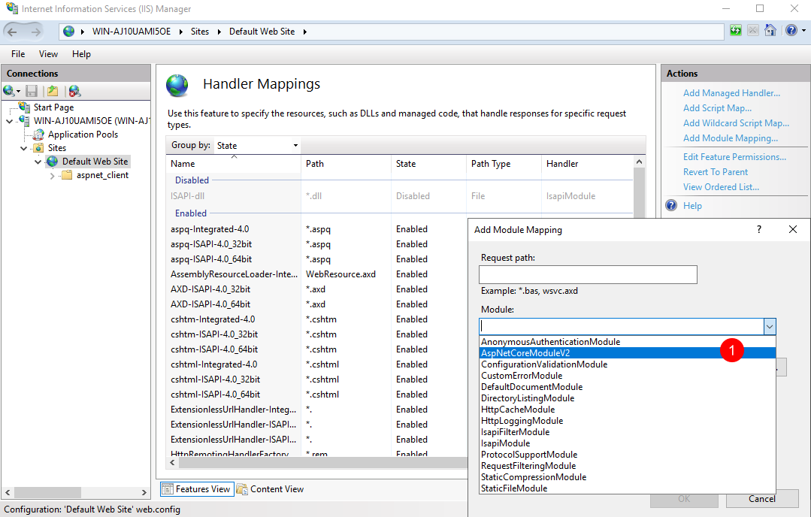
Runtime installation
Restart IIS
Confirm ASP.NET Core/.NET Core Runtime and Hosting Bundle 3.1.8
Confirm Module
AspNetCoreModuleV2

Slide 14
Content
1
Environmental And runtime list
2
Windows server settings and IIS installation
3
Runtime installation
4
MSSQL And SSMS installation
5
Platform installation Restore data DEMO
©2020 Shanghai Hourglass Engineering Software Ltd.

Slide 15
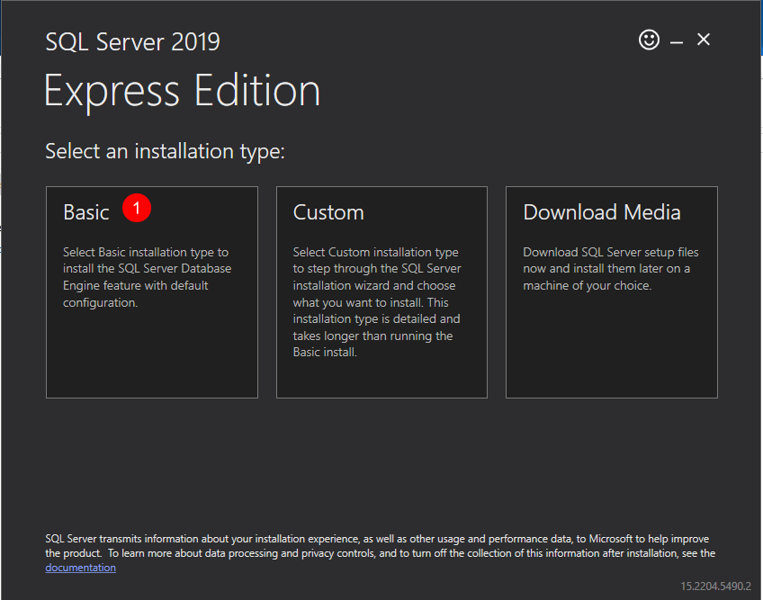
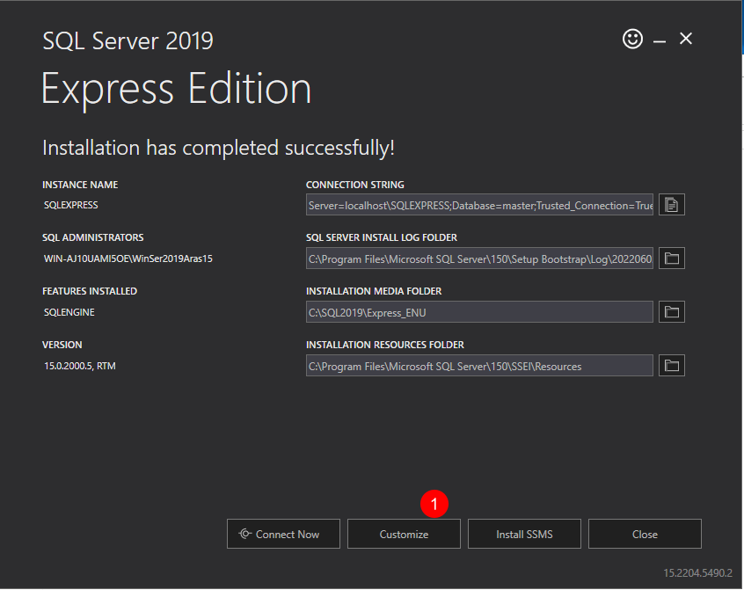
MSSQL installation

Slide 16
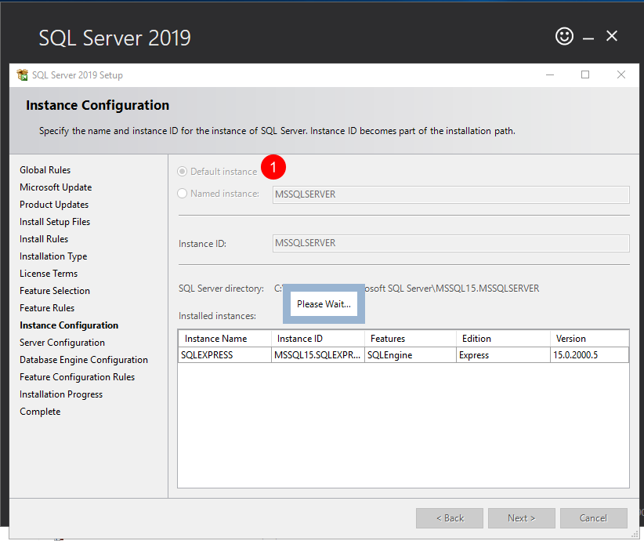
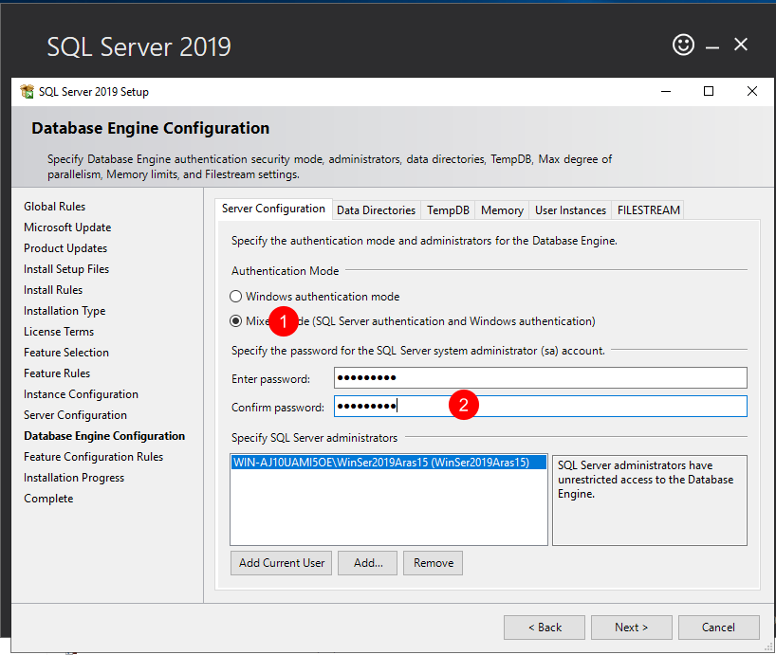
MSSQL installation

Slide 17
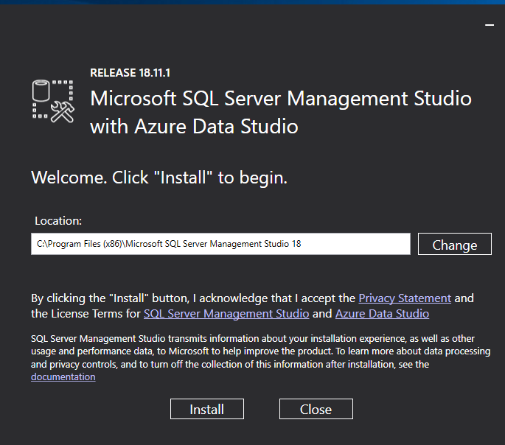
SSMS installation

Slide 18
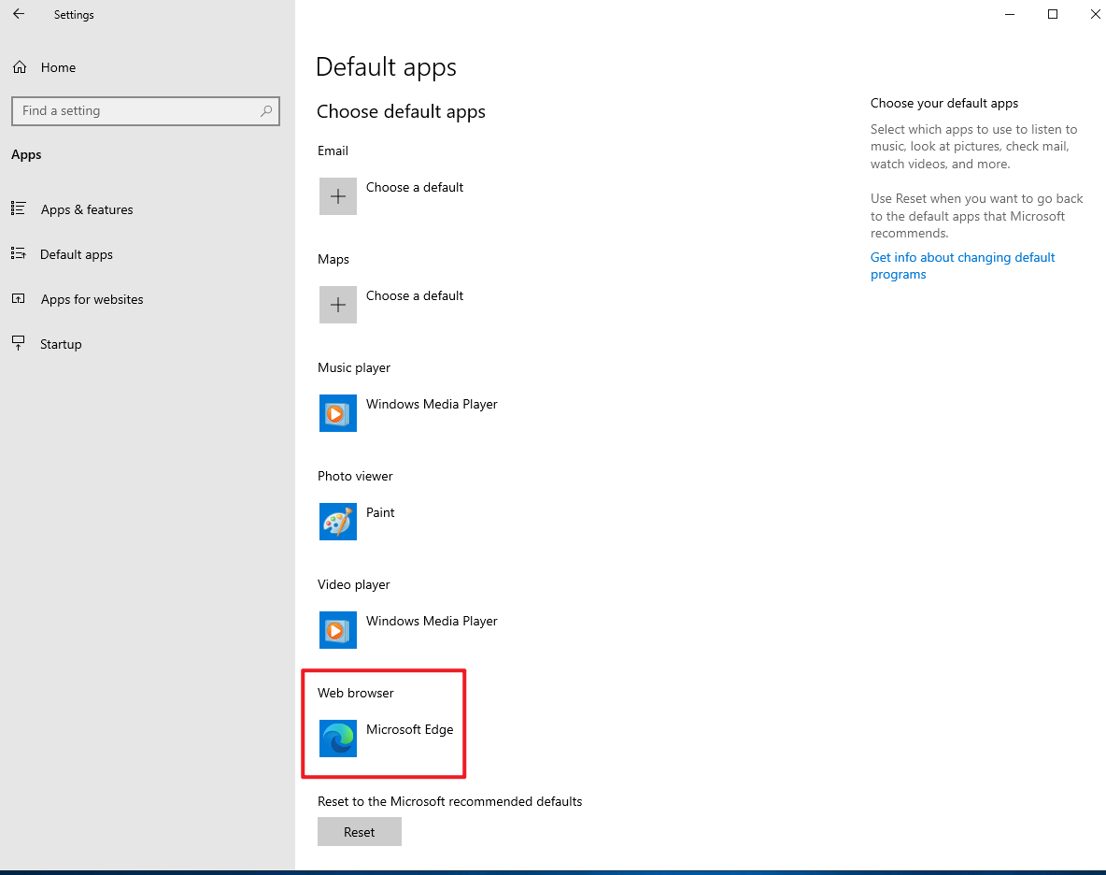
Microsoft Edge Setup
After installation, set the default browser

Slide 19
Content
1
Environmental And runtime list
2
Windows server settings and IIS installation
3
Runtime installation
4
MSSQL And SSMS installation
5
Platform installation Restore data DEMO
©2020 Shanghai Hourglass Engineering Software Ltd.

Slide 20
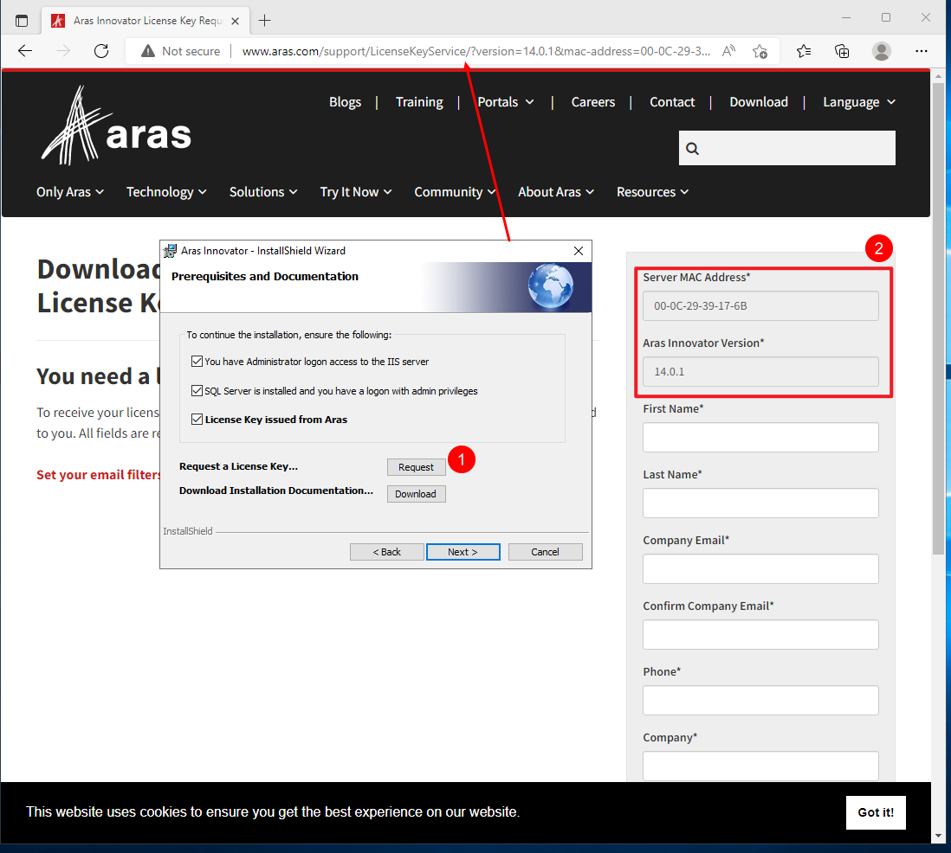
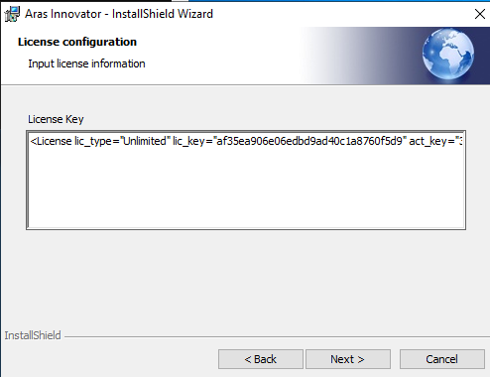
Platform installation
Details [Aras Innovator 15 - Installation Guide.pdf]
2.2 Obtaining a Framework License
3 Installing Aras Innovator
Confirm Application
Aras Innovator version 14.0.1

Slide 21
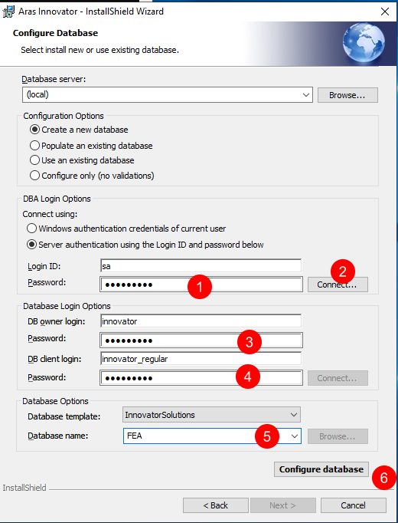
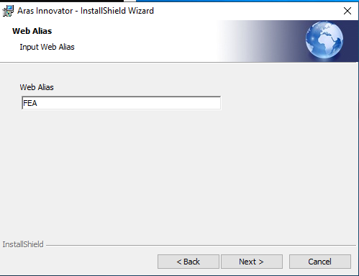
Platform installation
Details [Aras Innovator 15 - Installation Guide.pdf]
3 Installing Aras Innovator
Site and database are FEA

Slide 22
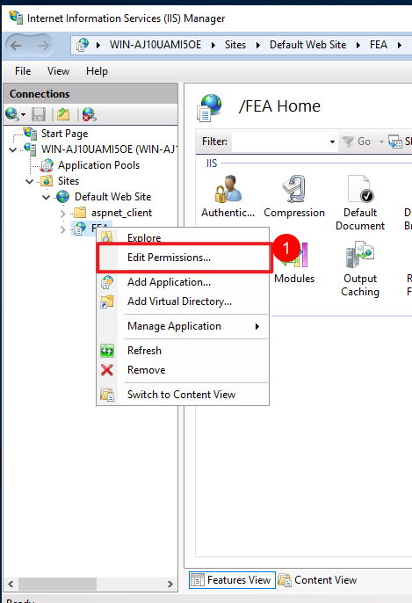
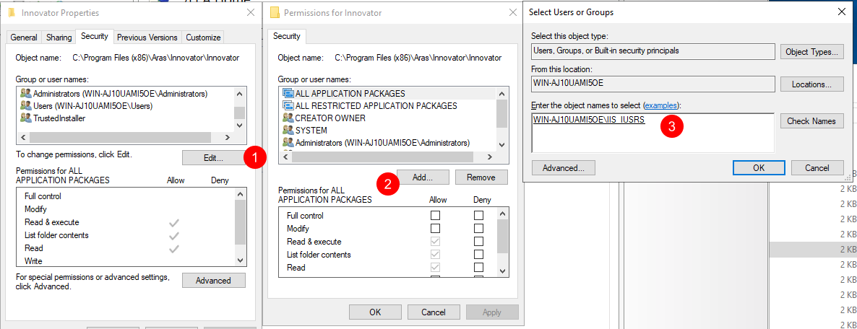
Platform installation
Set permissions->IIS_IUSER

Slide 23
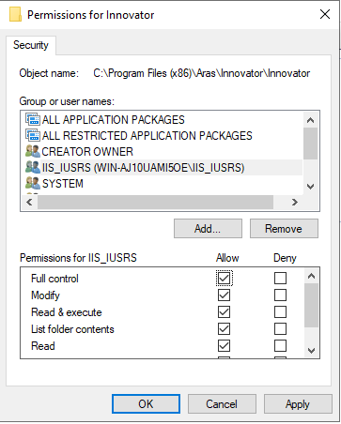
Platform installation
Set permissions->IIS_IUSER

Slide 24
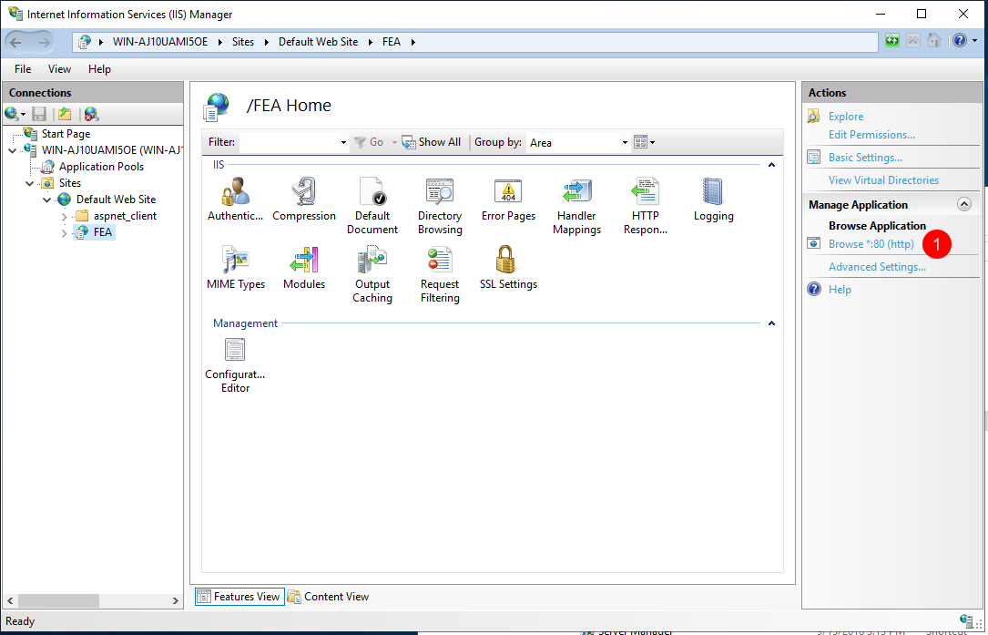
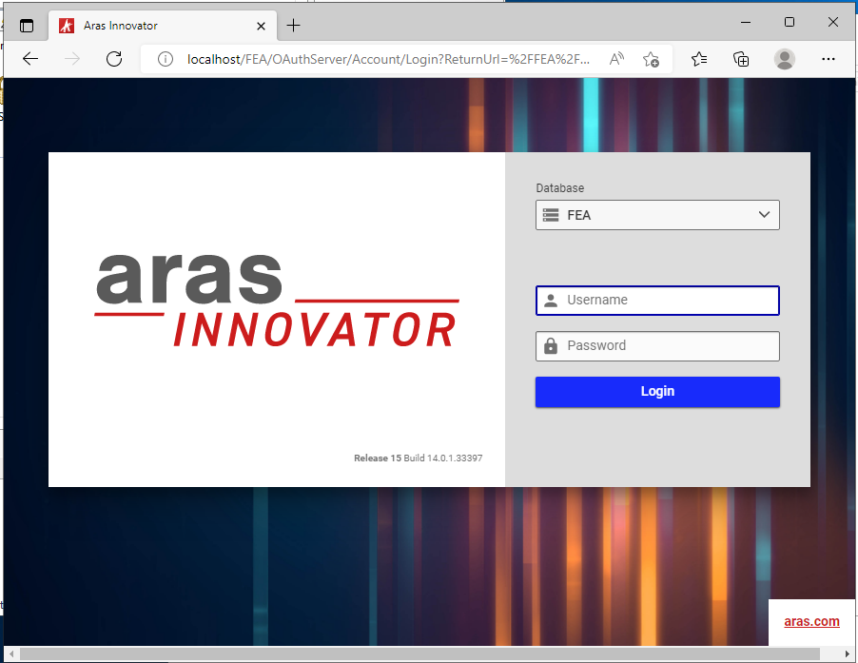
Platform installation
Verify that the platform installation was successful
Username:admin
Password:innovator

Slide 25
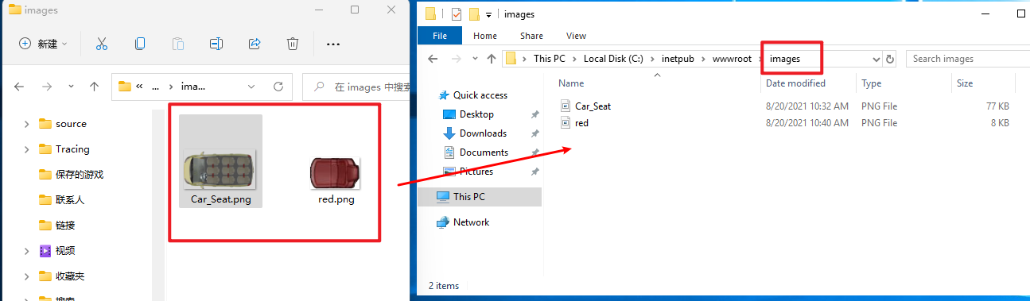
Restore data DEMO
images.zip Restore resource files
C:\inetpub\wwwroot

Slide 26
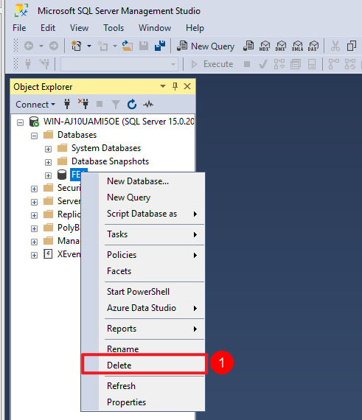
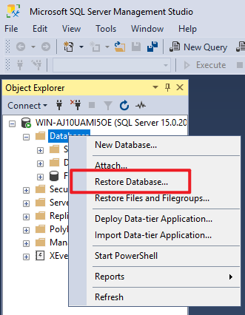
Restore data DEMO
Open Microsoft SQL Server Management Studio 18
Restore database
1. Delete the original database

Slide 27
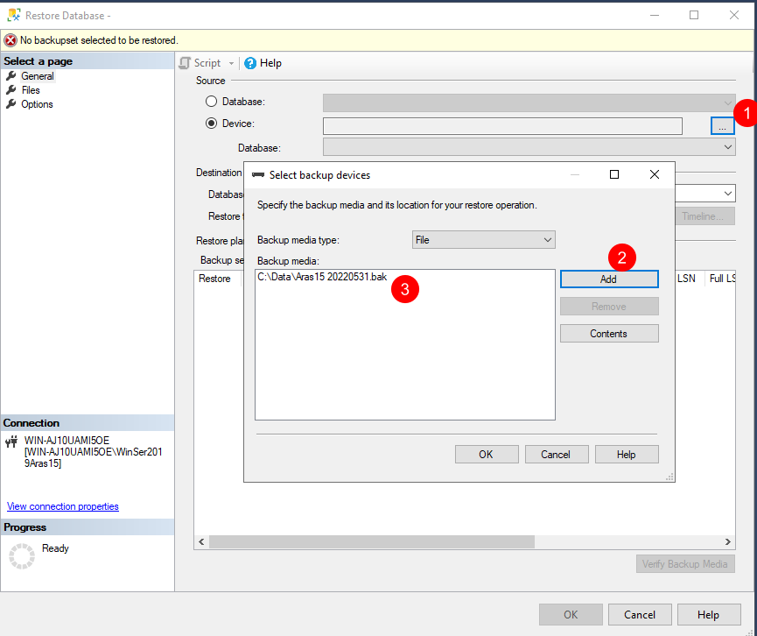
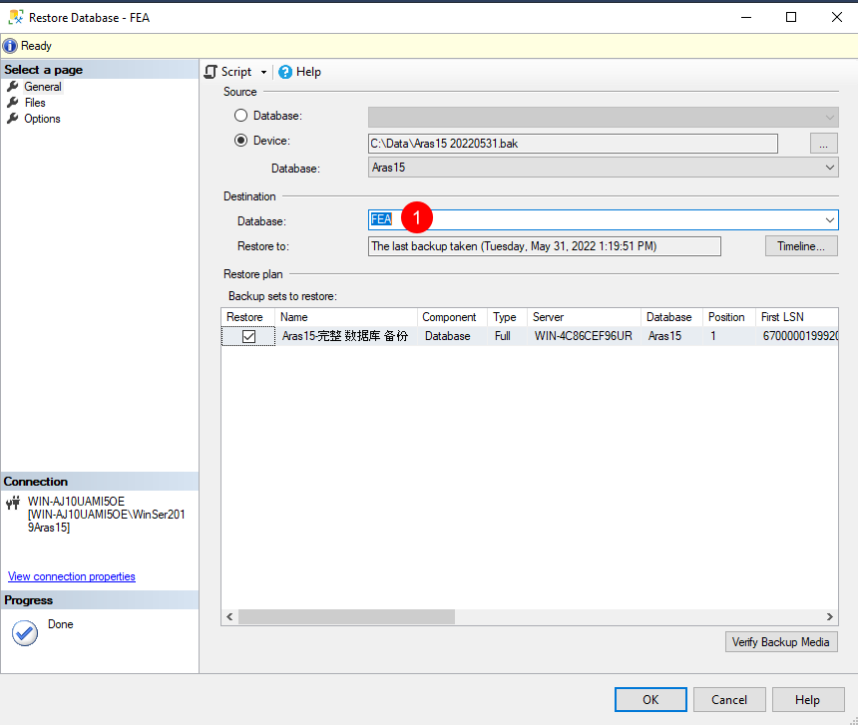
Restore data DEMO
Input FEA

Slide 28
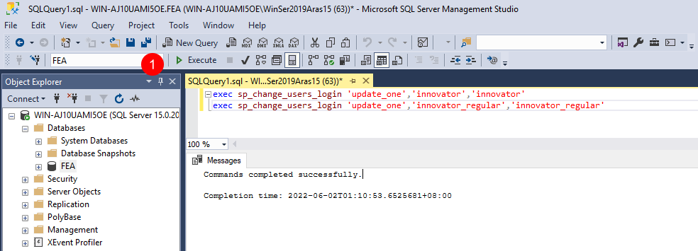
Restore data DEMO
Execute script

Slide 29
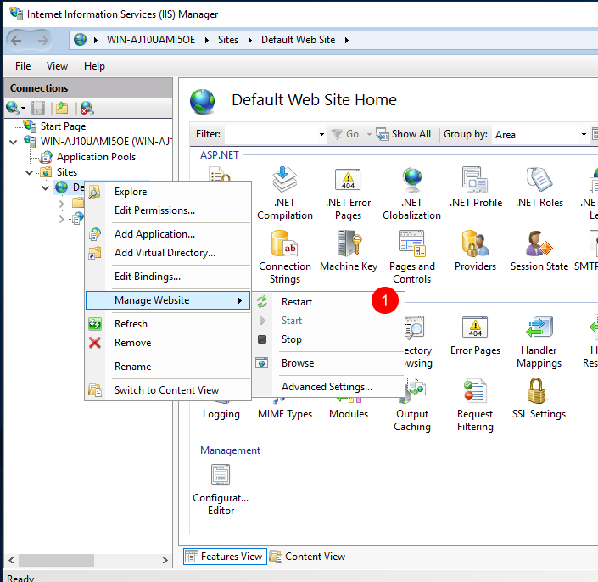
Restore data DEMO
Restart IIS

Slide 30
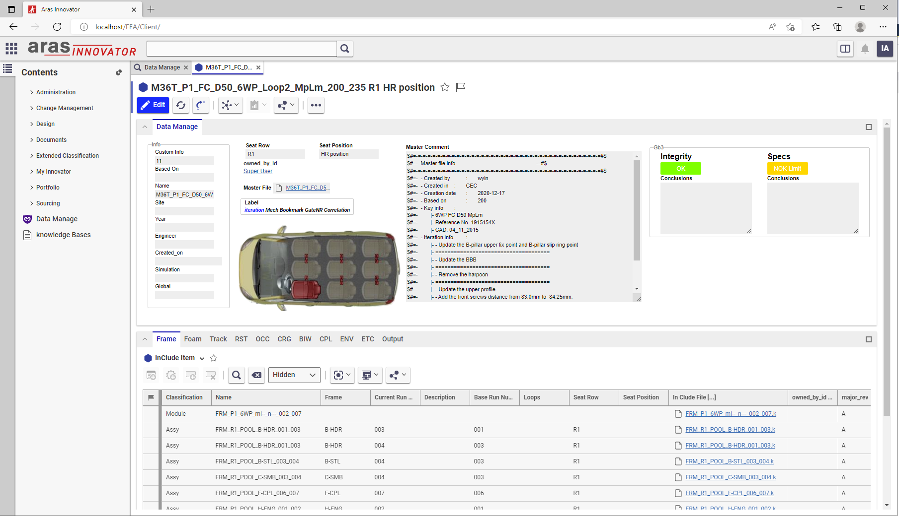
Restore data DEMO
Verify demo

Slide 31
End
thank you!
Notes:
在线浏览

